Slide 1



University of Roehampton
WEB DESIGN 2
Roshni Nasit - A00029991

Slide 2

University of Roehampton
Overview of project
Showcase courses, placements, and institute credentials.
Engage prospective students with demo classes and admission info.

Slide 3

University of Roehampton
Pages
Home
College Courses
Blog
About
Contact

Slide 4

University of Roehampton
Project Goals
- User-friendly interface
- Responsive design (mobile-friendly)
- Easy access to website

Slide 5

University of Roehampton
Tools & Technologies
- *Frontend:* React.js, Bootstrap, CSS
- *Routing:* React Router
- *Version Control:* Git & GitHub
- *Others:* netlify
Business Sales

Slide 6
University of Roehampton
Website Features
Home Page – Overview of the institution
About Us – Mission, Vision, History
Courses/Programs – List of offered courses
Contact Us – Form with validation
blogs -The latest industry news

Slide 7
University of Roehampton
Challenges Faced
- Designing responsive UI for all devices
- Routing and navigation
- Managing state across components
Business Sales

Slide 8
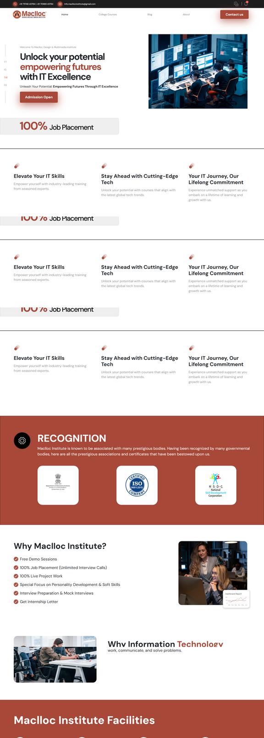
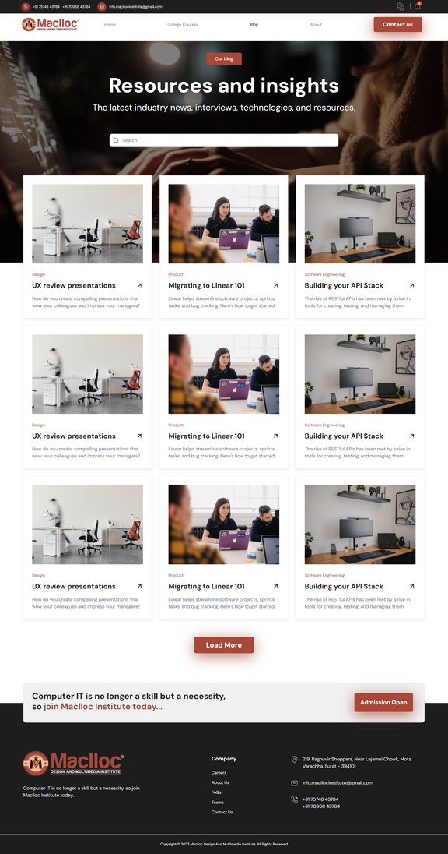

University of Roehampton
Pages Preview

Slide 9

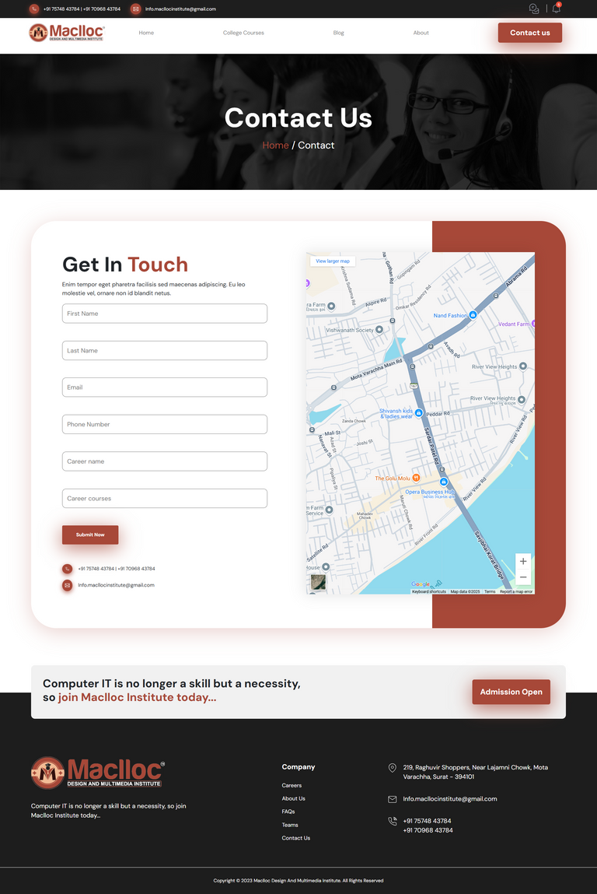
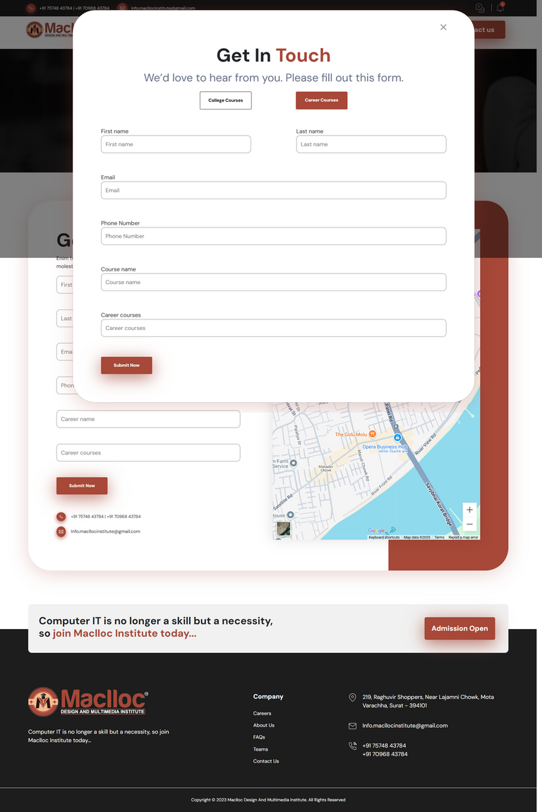
University of Roehampton
Pages Preview

Slide 10

University of Roehampton
Links
Git Link
live deployment link
https://github.com/Nasitr/maclloc--webdesign2/tree/master
live deployment link

Slide 11

University of Roehampton
Thank You

